Slide 1
Roslyn Analyzers in Visual Studio
John Koerner

Slide 2
What’s Roslyn?
Codename for .Net Compiler Platform
Provides APIs for Analyzing and Refactoring Code
Notes:
Released with Vs2015 and supports C# and VB (sorry F# fans)

Slide 3
What are Analyzers?
Design & Build time checks of your code
Check code for:
Style
Team Standards
Security Vulnerabilities
Potential Bugs
Notes:
Whitespace in code, tabs vs. spaces, SQL Injection, off by 1 errors.

Slide 4
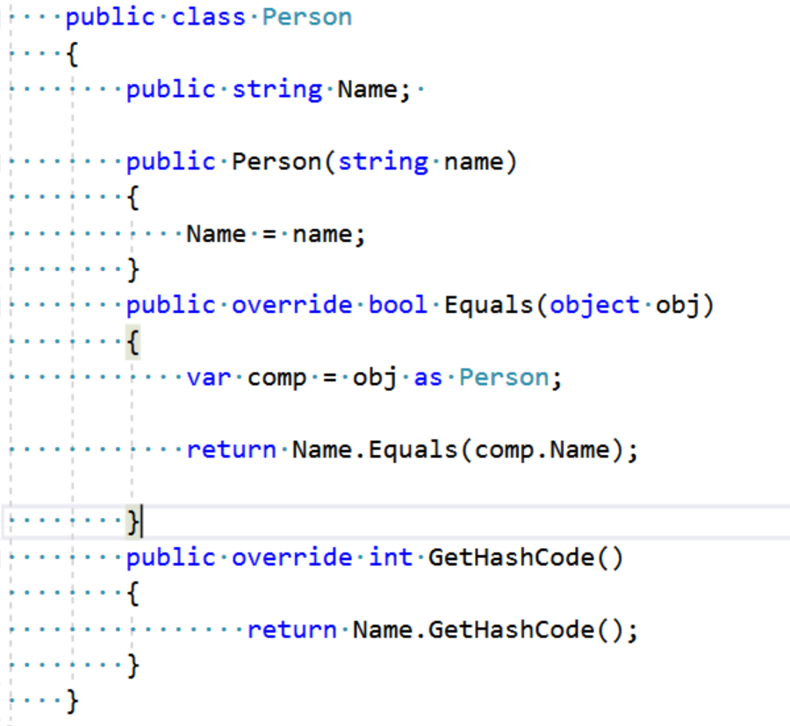

Slide 5
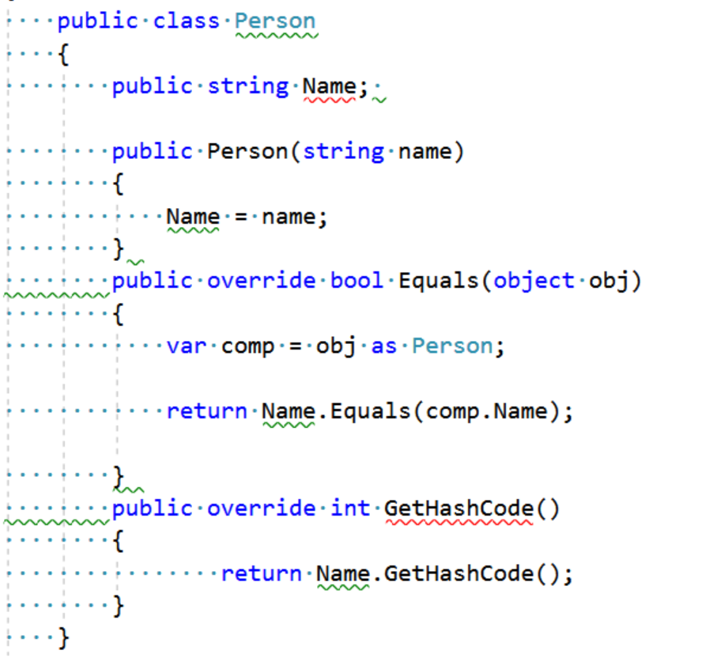

Slide 6
DEMO

Slide 7

Resources
Analyzers:
StyleCop: https://github.com/DotNetAnalyzers/StyleCopAnalyzers
Sonar Analyzers: https://www.sonarsource.com/products/codeanalyzers/sonarcsharp.html
Fx Cop Analyzers: https://github.com/dotnet/roslyn-analyzers
Creating your first analyzer
GitHub Repo for this Talk: https://github.com/johnkoerner/AnalyzersLightningTalk

